Slide 1
STAT 7900: Special Topic:
Causal Analysis
Instructor
Dhrubajyoti Ghosh
KENNESAW STATE UNIVERSITY
STAT 7900

Slide 2
Three Kinds of questions
Descriptive
What is happening?
Example: How does blood pressure differ between smokers and non-smokers?
Predictive
What will happen?
Example: Can age, BMI or smoking predict future blood pressure?
Causal
What would happen if we intervened?
Example: Would smoking cessation lower blood pressure?

Slide 3
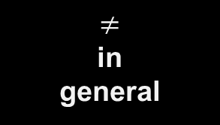
Association is not causation
Observed association
$≠$
in
general
Causal effect
E[Y | T = 1] − E[Y | T = 0]
E[Y(1)] − E[Y(0)]
Why can they differ?
• Confounding: treated and untreated groups may differ before treatment.
• Selection and treatment decisions can create strong associations without causal effects.
• Simpson’s paradox: aggregate and within-group comparisons can point in different directions.
Key idea: correlation can be a mixture of causal and noncausal association.

Slide 4
Formulating a causal question
Five ingredients of a causal question
1
Population
Who?
2
Treatment
What intervention?
3
Comparator
Compared with what?
4
Outcome
What endpoint?
5
Time
Over what horizon?

Slide 5
Potential Outcomes
World 1
Treatment Received
A = 1
Outcome: Y(1)
World 2
No treatment
A = 0
Outcome: Y(0)

Slide 6






Fundamental Problem of Causal Inference
If $T_{i} = 1$
FACTUAL
If $T_{i} = 0$
↔
Observed: $Y_{i}(1)$
Observed: $Y_{i}(0)$
Missing: $Y_{i}(0)$
COUNTERFACTUAL
Missing: $Y_{i}(1)$
Causal inference is therefore a structured missing-data problem.

Slide 7




What causal effects we are trying to estimate
ATE:
$$E[Y(1) − Y(0)]$$
Average effect in the target population
ATT
ATC
CATE(x)
$$E[Y(1) − Y(0) | T=1]$$
$$E[Y(1) − Y(0) | T=0]$$
$$E\left[Y\left(1\right)− Y\left(0\right)\right|X=x]$$
Effect among those untreated
Effect in a covariate-defined subgroup
Effect among those treated
“Does the treatment work?” is incomplete until we specify for whom and which estimand.

Slide 8
Causal Assumptions
Consistency
Exchangeability
Observed Y equals the potential outcome under the treatment actually received.
After conditioning on X, treatment is independent of the potential outcomes.
Positivity
SUTVA / no interference
Within relevant X strata, each treatment option has positive probability.
One unit’s treatment does not alter another unit’s outcome; treatment is well defined.
These assumptions are not fully testable from the observed data alone.

Slide 9
Bridge to today
A statistical model can always produce an estimate.
The causal question is whether the assumptions justify interpreting it as an effect.
Causal
question
→
Causal
assumptions
→
→
Identification
Estimation
Last lecture: “Assume exchangeability after conditioning on X.”
Today’s question: Which variables belong in X — and which variables should we NOT adjust for?
→ Directed Acyclic Graphs (DAGs)

Slide 10


Slide 11
Today: Assumptions to Adjustment
Why causal graphs? What a DAG does, and does not, claim.
Nodes, arrows, parents, descendants, and paths.
The three fundamental structures: chain, fork, collider.
d-separation: when conditioning blocks or opens a path.
Backdoor paths and valid covariate-adjustment sets.
Why “control for everything” can create bias.
R coding lab: confounding, mediation, and collider bias.

Slide 12
Conditional Exchangeability
$$Y(t) ⟂ T | X$$
Within levels of X, treatment assignment carries no additional information about the potential outcomes.
But what belongs in X?

Slide 13
Dangerous Instinct: Adjust for Everything
A common regression instinct:
Put every available covariate in the model. More adjustment must be safer.
That is false for causal inference.
Some variables remove bias.
Some variables remove part of the effect you want.
Some variables CREATE bias when conditioned on.

Slide 14
Why use a graph
Potential outcomes define the causal estimand precisely.
Graphs encode assumptions about how variables generate one another.
Those assumptions imply which associations should disappear after conditioning.
The graph helps us decide whether a causal effect is identifiable, and what to adjust for.
Potential outcomes tell us WHAT effect means; DAGs help organize WHY identification may be possible.

Slide 15
DAG
D : Directed, A : Acyclic, G : Graph.
Directed: arrows have orientation.
Acyclic: following arrows can never bring you back to the same node.
Graph: nodes connected by edges.
A causal arrow is a scientific claim.
X
Y
exposure
outcome
Means: intervening on X could change Y through a direct causal mechanism represented by this edge.

Slide 16
DAG
No arrow is also an assumption.
X
Y
Z
asserts that the graph does not include a direct causal effect of X on Z, given the variables represented.
Graphical conclusions are only as credible as the causal assumptions used to draw the graph.

Slide 17
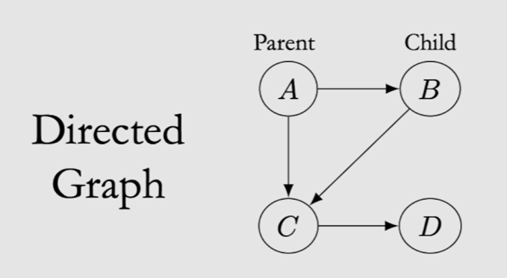
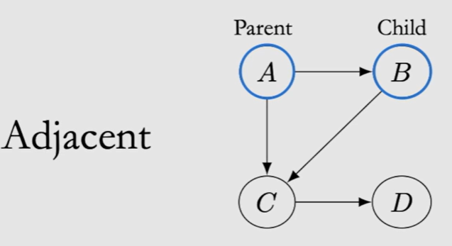
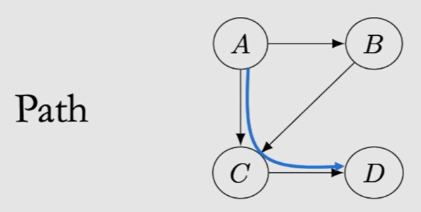
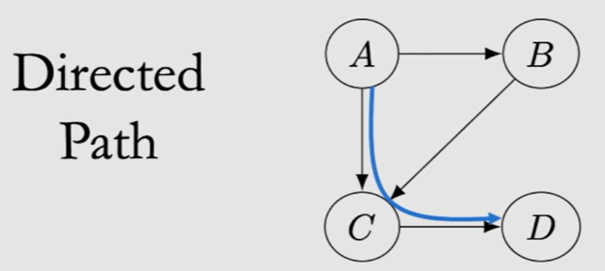
DAG: Directed Acyclic Graph

Slide 18
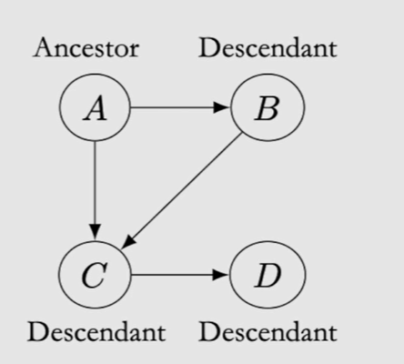
DAG
A
B
C
D
Ancestors of C: A,B
Descendents of A: B, C, D
Ancestors mean there is a directed path onto the node.

Slide 19
DAG: Directed Acyclic Graph
DAG
NOT DAG
A
B
A
B
D
C
D
C

Slide 20
DAG: Directed Acyclic Graph
MEDICAL EXAMPLE
A
B
C
Age
Treatment
Recovery
Age and baseline severity influence both treatment choice and recovery; treatment itself may improve recovery.
D
Severity

Slide 21
DAG: Directed Acyclic Graph
A
B
C
D
E
Parents of C? 2. Descendants of B?
3. Ancestors of D? 4. Is E an ancestor of D?

Slide 22
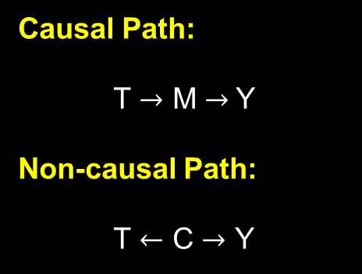
Paths
A path is a sequence of adjacent edges, regardless of arrow directions.
A directed path is where every arrow must point along the path.
Causal Path:
T $→$ M $→$Y
Non-causal Path:
T $←$ C $→$ Y
C
confounder
T
M
Y
treatment
mediator
outcome

Slide 23

Three Building Blocks
CHAIN
FORK
COLLIDER
X $→$ Z $→$ Y
X ← Z → Y
X → Z ← Y
Transmission
of association
Common cause
confounding
Common effect
selection
Conditioning behaves differently in the collider.

Slide 24

Structure 1: Chain
CHAIN
X
Z
Y
X influences Y through Z.
Without conditioning: path open.
X and Y can be associated.
Intuition: once Z is known, X supplies no additional information about Y through this chain.
$X ⟂ Y | Z$(for this path)

Slide 25

Structure 2: Fork / Common Cause
FORK
X
Z
Y
A shared cause can make X and Y associated even when X does not cause Y.
Stratifying on the common cause
removes the spurious pathway
through Z.
$X ⟂ Y | Z$(for this fork)

Slide 26
Structure 2: Fork / Common Cause
FORK
Z
Disease Severity
Y
X
Treatment
Mortality
Severe patients are more likely to receive treatment AND more likely to die.

Slide 27
Structure 3: Collider / Common Effect
COLLIDER
Z
X
Common Effect
Y
Knowing X tells us nothing about Y merely because they share a consequence.
Without conditioning on Z, the path is closed.
After conditioning on Z, X and Y can be associated.
This is collider bias / selection bias.

Slide 28
Structure 3: Collider / Common Effect
Example
Admissions to an elite program depend on BOTH academic score and special talent.
A
S
Academic score
D
Special Talent
Admitted
Among admitted students only, a lower academic score may imply greater special talent.

Slide 29
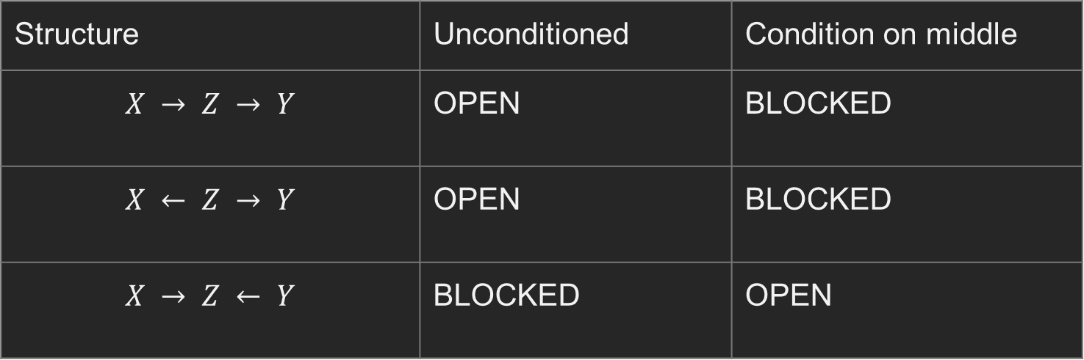
Chains, forks, colliders: One table to remember
Structure | Unconditioned | Condition on middle
$$X → Z → Y$$ | OPEN | BLOCKED
$$X ← Z → Y$$ | OPEN | BLOCKED
$$X → Z ← Y$$ | BLOCKED | OPEN
Collider = the exception: conditioning OPENS instead of closes.

Slide 30
Open or Closed
For each path, say whether it is OPEN before conditioning and after conditioning on Z.
A. X → Z → Y
B. X ← Z → Y
C. X → Z ← Y

Slide 31
Open or Closed
For each path, say whether it is OPEN before conditioning and after conditioning on Z.
A. X → Z → Y
B. X ← Z → Y
C. X → Z ← Y
Chain
Fork
Collider

Slide 32

d-Separation
Two variables are d-separated by a set S when EVERY path between them is blocked after conditioning on S.
$$X ⟂ᴅ Y | S$$
Graphical separation → conditional independence under the causal Markov property.

Slide 33
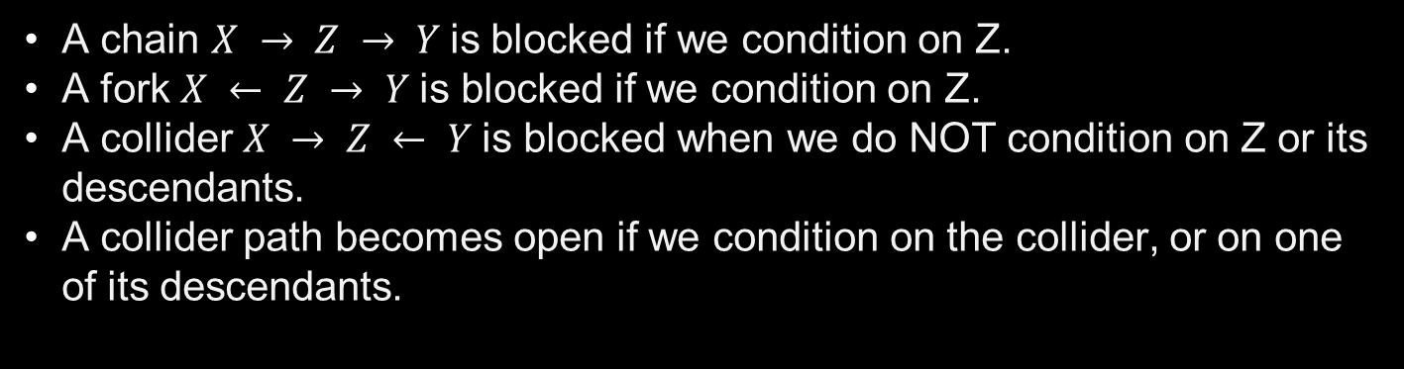
d-Separation
RULES
A chain $X → Z → Y$is blocked if we condition on Z.
A fork $X ← Z → Y$is blocked if we condition on Z.
A collider $X → Z ← Y$is blocked when we do NOT condition on Z or its descendants.
A collider path becomes open if we condition on the collider, or on one of its descendants.
To d-separate X and Y, EVERY path between them must be blocked.

Slide 34



d-Separation
$Z∈S$, the chain is blocked by conditioning on $Z$.
X
Z
Y
$Z∈S$, the backdoor fork is blocked by conditioning on $Z$.
X
Z
Y
$Z∉S$, the collider path is blocked automatically.
X
Z
Y

Slide 35
d-Separation
Conditioning on a DESCENDANT of a collider can open the path.
X
Y
Conditioning on D gives information about Z, which activates the collider path.
Z
D

Slide 36

d-Separation
Suppose hospital admission $H$ is a collider.
Disease Severity $→$ $H$ $←$ Insurance Status.
Now suppose “received ICU bed” is caused by $H.$
$H→$ICU Bed.
Selecting on ICU-bed recipients can indirectly select on H and induce collider bias.

Slide 37
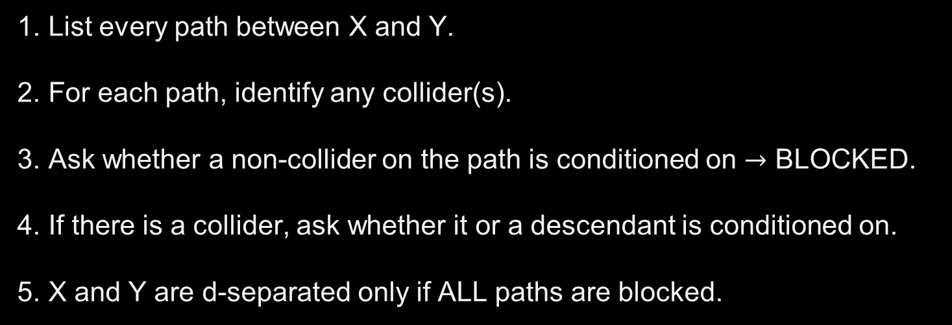
A practical d-Separation Algorithm
WORKFLOW
1. List every path between X and Y.
2. For each path, identify any collider(s).
3. Ask whether a non-collider on the path is conditioned on $→$ BLOCKED.
4. If there is a collider, ask whether it or a descendant is conditioned on.
5. X and Y are d-separated only if ALL paths are blocked.

Slide 38


d-Separation: Exercise
WORKFLOW
C
Conditioning set: $S = \{C\}$
T
M
Y
Question: $T ⟂ᴅ Y | C$?

Slide 39
d-Separation: Exercise 1
NO.
Path 1: T ← C → Y
blocked by conditioning on C
Path 2: T → M → Y
still open
d-separation requires EVERY path to be blocked.

Slide 40

d-Separation: Exercise 2
T
U
Y
Consider the path $T→S←U→Y$
What happens if we condition on $S$?
S
Condition on S
Without conditioning on S
S is a collider.
T → S ← U → Y is BLOCKED at S.
This path does not transmit association.
The collider is activated.
The path becomes OPEN.
T can now become associated with Y through U.

Slide 41


d-Separation: Exercise 3
A
B
C
Find a conditioning set that d-separates $T$and $Y$.
T
M
Y
Three paths:
$T→M→Y :$ Path 1 – Open, chain.
$T←A→B→Y :$ Path 2 – Open, Backdoor path.
$T→M←C→Y :$ Path 3 – Closed, M is a collider.

Slide 42

d-Separation: Exercise 3
A
B
C
Find a conditioning set that d-separates $T$and $Y$.
T
M
Y
Path 1 is an ordinary chain and is open by default.
The only internal node on this path is $M$. Therefor to block this path, we must condition on $M$. So any d-separation set should contain $\{M\}$.

Slide 43

d-Separation: Exercise 3
A
B
C
Find a conditioning set that d-separates $T$and $Y$.
T
M
Y
Path 2 is also open by default. There are no colliders.
We can block it by conditioning on either $A$ or $B$.
The conditioning set must also contain $\{A\}$ or $\{B\}$.

Slide 44

d-Separation: Exercise 3
A
B
C
Find a conditioning set that d-separates $T$and $Y$.
T
M
Y
So is $\{M, A\}$ enough?
Look at Path 3. $\{M\}$ is a collider, so conditioning on it opens Path 3. So we have to close it again. For that, we need to condition on $\{C\}$.

Slide 45

d-Separation: Exercise 3
A
B
C
Find a conditioning set that d-separates $T$and $Y$.
T
M
Y
$\{M\}$ is required for Path 1, $\{A\}$ or $\{B\}$ is required for Path 2. $\{C\}$ is required because conditioning on $\{M\}$ opens Path 3.
d-separation sets: $S=\left\{A, M, C\right\}$ or $\left\{B,M,C\right\}.$

Slide 46
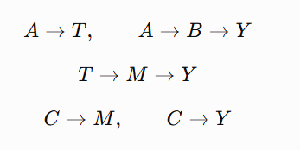

d-Separation: Exercise 3
A
B
C
Find a conditioning set that d-separates $T$and $Y$.
T
M
Y
$T:$Receiving an intense treatment.
$Y:$ Recovery.
$M:$ Biological response to treatment.
$A:$ Baseline disease severity.
$B:$ Baseline organ damage.
$C:$Genetic risk factor.

Slide 47


d-Separation ≠ Causal Adjustment
d-SEPARATION
Question:
Can we make T and Y conditionally independent?
Goal: BLOCK ALL paths.
CAUSAL ADJUSTMENT: TOTAL EFFECT
Question:
What should we condition on to identify the total effect?
Goal: BLOCK NONCAUSAL backdoor paths.
Example:
Backdoor path:
T $←$ C $→$ Y
C
Causal path:
T $→$ M $→$ Y
T
M
Y
For total effect: adjust for C,
not M.

Slide 48

Backdoor path
C
A path from $T$ to $Y$ that begins with an arrow INTO $T.$
Y
T
Choose a set S that blocks every backdoor path from T to Y.
Do not include descendants of T in a standard total-effect adjustment set.
After blocking backdoor paths, the remaining association from T to Y can be interpreted causally under the graph’s assumptions.
Block noncausal paths. Leave causal paths open.

Slide 49
Backdoor path
C
Backdoor path: T ← C → Y
Y
T
Conditioning on C blocks the backdoor path without blocking T → Y.

Slide 50
Backdoor path
A
B
Backdoor paths
T ← A → Y and T ← B → Y
Y
T
Need to block BOTH paths: adjust for A and B.

Slide 51
Minimal Adjustment Set
A valid adjustment set is MINIMAL if removing any variable from it would leave at least one backdoor path open.
Valid set
{Age, Severity, Sex}
Minimal?
Depends on the graph

Slide 52

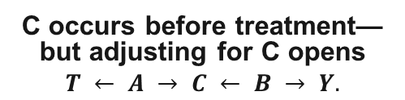
“Pre-treatment” does NOT mean “adjust for it”
A
B
C
C occurs before treatment—but adjusting for C opens
$$T ← A → C ← B → Y.$$
pre-treatment collider
T
Y
Example:
T = applicant attended an expensive private high school
$Y$= admission to a selective university
$A$= family wealth
$B$= parental education
$C$= participation in an elite pre-college enrichment program

Slide 53
Post-Treatment variables
T
M
Y
post-treatment
M is caused by T.
If estimating the TOTAL effect of T on Y, adjusting for M blocks part of the effect.

Slide 54
Mediator: part of the causal mechanism
MEDIATION
T
M
Y
Exercise
Weight-loss
Blood Pressure
Total effect = direct pathway $+$ mediated pathway.
Adjusting for M changes the estimand.

Slide 55
Total Effect vs Direct Effect
TOTAL EFFECT
DIRECT / MEDIATED EFFECTS
Question:
What happens to Y if we intervene on T?
Do NOT block causal mediators when the total effect is the target.
Question:
How much of the effect operates through M?
This is a different estimand and requires mediation-specific assumptions.

Slide 56


Collider adjustment bias with randomized T
T
U
Conditioning on M opens:
T → M ← U → Y
M
Y
If you adjust for weight loss $M$, you induce an association between treatment and frailty, and that can bias the treatment effect on survival.
Randomization protects you at baseline, but you can destroy that protection by conditioning on the wrong post-treatment variable.
Example:
T: randomized chemotherapy
$M$: treatment-induced weight loss
$U$: underlying frailty
$Y$: survival

Slide 57

M-bias
U₁
U₂
Without adjusting for M, the path
$T ← U₁ → M ← U₂ → Y$is blocked at M.
M
observed collider
T
Y
Not every predictor of treatment or outcome is a confounder.
A variable can be statistically associated with both T and Y yet still be a bad adjustment variable.
Real-world covariate choice should combine subject-matter knowledge, temporal ordering, and causal structure.

Slide 58
Overadjustment Bias
Overadjustment usually means conditioning on a variable that lies on, or is caused by, a causal pathway you intend to estimate.
T
M
Y
Adjust for M → estimated “effect of T” no longer contains T $→$ M $→$ Y.

Slide 59
Selection Bias
D
R
disease
risk factor
H
hospitalized
If your dataset contains only H = 1 patients, you have conditioned on a collider.
Inside the hospital, D and R can appear associated even if they are independent in the population.

Slide 60
Selection can happen before analysis starts
Eligibility criteria can condition on a collider.
Complete-case analysis can condition on causes of missingness.
Survey response can depend on both exposure and outcome-related factors.
Clinic-based samples can differ systematically from the source population.
Ask: “What had to happen for someone to enter my dataset?”

Slide 61
How to draw a DAG from a research question
1. Define treatment/exposure T and outcome Y clearly.
2. List causes of T, causes of Y, and common causes.
3. Add plausible mediators and important selection variables.
4. Respect temporal ordering whenever possible.
5. Draw arrows from cause to consequence, not from correlation to correlation.
6. Use the graph to inspect backdoor paths and identify adjustment sets.

Slide 62
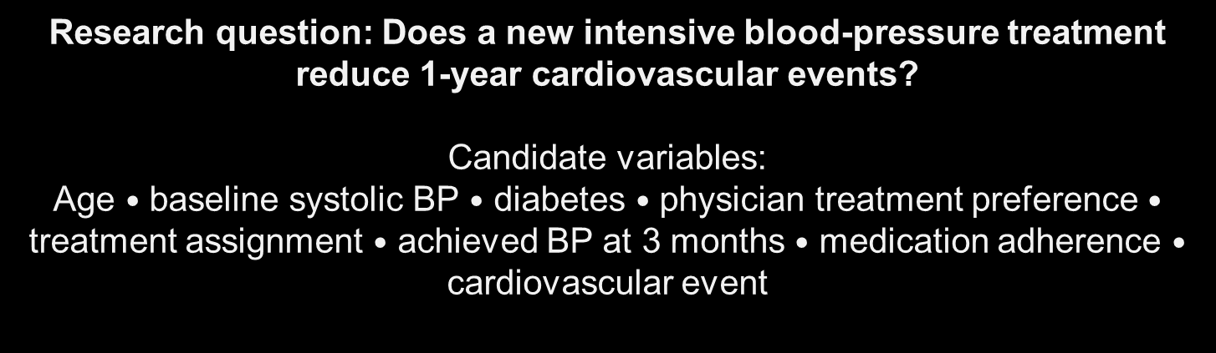
Build a graph
Research question: Does a new intensive blood-pressure treatment reduce 1-year cardiovascular events?
Candidate variables:
Age $•$ baseline systolic BP $•$ diabetes $•$ physician treatment preference $•$ treatment assignment $•$ achieved BP at 3 months $•$ medication adherence $•$ cardiovascular event
Draw plausible DAG. Circle the variables you would adjust for to estimate the TOTAL treatment effect.

Slide 63
One plausible DAG
Age
BP
DM
Pref
T
3m BP
Adh
Y

Slide 64
For TOTAL effect, what would we adjust for?
GOOD CANDIDATES
DO NOT AUTOMATICALLY ADJUST
Baseline causes of treatment and outcome:
• baseline BP
• diabetes
• age (if it causes outcome and/or treatment through measured paths)
• physician preference if it lies on an open backdoor path between treatment and outcome.
Post-treatment variables:
• achieved 3-month BP
• adherence
These may mediate the treatment effect or become colliders.

Slide 65

What did the graph buy us?
$$Y(t) ⟂ T | X$$
Last class:
Today:
Use a DAG to justify a set X that blocks all backdoor paths.
Then the graphical assumptions support conditional exchangeability for the causal effect of interest.
Graphical identification is the bridge from assumptions to an estimable formula.

Slide 66
After block backdoor paths: adjustment formula
$$E\left[Y\left(t\right)\right] = \sum_{x}{E[Y | T=t, X=x]P(X=x)}$$
ATE = E[Y(1)] − E[Y(0)]
The DAG helps justify WHICH X makes this identification step valid.
Regression, matching, weighting, and g-computation are estimation strategies after identification.

Slide 67
A DAG does not prove causality
The arrows come from scientific knowledge, design, temporal order, and assumptions.
Observed data generally cannot determine a unique causal DAG by itself.
Multiple DAGs can imply the same set of observed conditional independences.
A correct-looking picture is not a substitute for substantive justification.
DAGs make assumptions visible; they do not make them automatically true.

Slide 68
Unmeasured confounding: Hidden U
U
T
Y
If U is unmeasured, ordinary adjustment cannot block $T ← U → Y$.

Slide 69
Measuring poorly is not same as measuring it
C*
true confounder
W
noisy measure
T
Y
Conditioning on W may leave residual confounding because W does not perfectly recover C*.

Slide 70
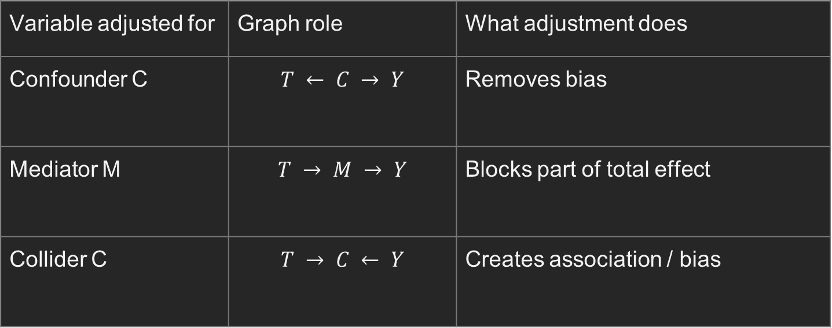
Summary
Variable adjusted for | Graph role | What adjustment does
Confounder C | $$T ← C → Y$$ | Removes bias
Mediator M | $$T → M → Y$$ | Blocks part of total effect
Collider C | $$T → C ← Y$$ | Creates association / bias
Regression syntax cannot tell you which causal role a covariate has.

Slide 71
Two branches of analysis
CAUSAL ANALYSIS WITH A DAG
CAUSAL DISCOVERY
Start with a scientifically motivated graph.
Use it to reason about identification, adjustment, and bias.
Use patterns of conditional independence and assumptions to learn aspects of graph structure.
Outputs may be equivalence classes (CPDAGs/PAGs), not one certain DAG.

Slide 72
R Lab Simulation
• Confounding can make a treatment effect look too large or too small.
• Adjusting for the right backdoor variable can recover the causal effect.
• Adjusting for a mediator changes the estimand: total effect → direct effect.
• Adjusting for a collider can create bias, even when treatment is randomized.
• The same DAG can lead to different conditioning choices for d-separation versus causal adjustment.
Predict first → run the code → explain the result from the DAG.

Slide 73
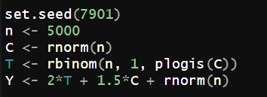
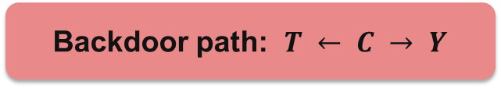
Simulation 1
C = baseline risk
C
T
Y
Treatment
Outcome
Backdoor path: $T ← C → Y$
True treatment effect in the simulation = 2
Will the crude model overestimate or underestimate the effect?

Slide 74
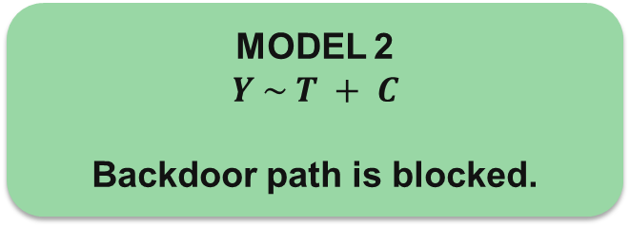
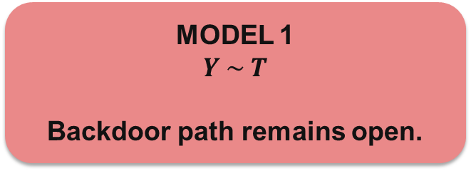

Simulation 1
set.seed(7901)
n <- 5000
C <- rnorm(n)
T <- rbinom(n, 1, plogis(C))
Y <- 2*T + 1.5*C + rnorm(n)
fit_crude <- lm(Y ~ T)
fit_adj <- lm(Y ~ T + C)
coef(fit_crude)["T"] – 3.18
coef(fit_adj)["T"] – 1.99
MODEL 1
$Y \sim T$
Backdoor path remains open.
MODEL 2
$Y \sim T + C$
Backdoor path is blocked.
Adjusted coefficient $≈$ 2

Slide 75
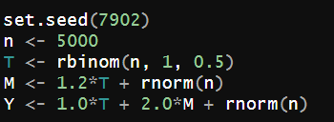
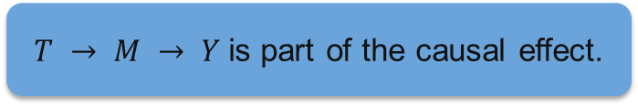
Simulation 2
M = mediator
M
T
Y
Treatment
Outcome
$T → M → Y$is part of the causal effect.
Target total effect? Do NOT condition on M.

Slide 76
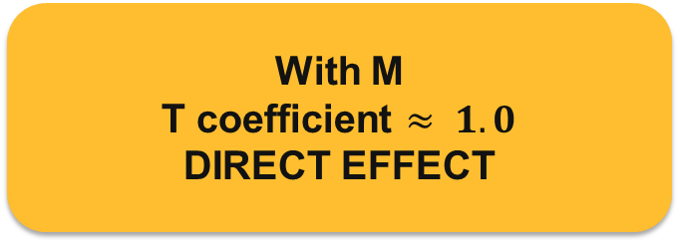
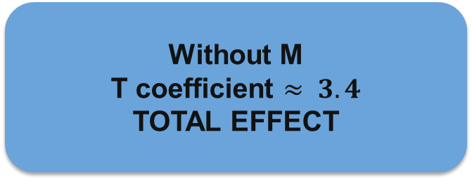
Simulation 2
set.seed(7902)
n <- 5000
T <- rbinom(n, 1, 0.5)
M <- 1.2*T + rnorm(n)
Y <- 1.0*T + 2.0*M + rnorm(n)
fit_total <- lm(Y ~ T)
fit_direct <- lm(Y ~ T + M)
coef(fit_total)["T"] - 3.38
coef(fit_direct)["T"] - 0.98
Without M
T coefficient $≈ 3.4$
TOTAL EFFECT
With M
T coefficient $≈ 1.0$
DIRECT EFFECT
Adding a covariate can change the scientific question.

Slide 77
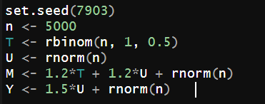
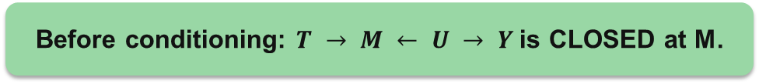
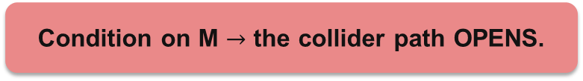
Simulation 3
Collider
U
M
T
Y
Treatment
Outcome
Before conditioning: $T → M ← U → Y$is CLOSED at M.
Condition on M $→$ the collider path OPENS.

Slide 78
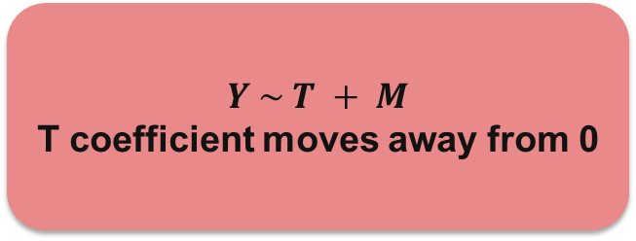
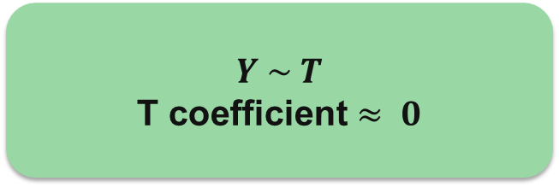
Simulation 3
set.seed(7903)
n <- 5000
T <- rbinom(n, 1, 0.5)
U <- rnorm(n)
M <- 1.2*T + 1.2*U + rnorm(n)
Y <- 1.5*U + rnorm(n) # no effect of T
fit_unadj <- lm(Y ~ T)
fit_col <- lm(Y ~ T + M)
coef(fit_unadj)["T"] - 0.009
coef(fit_col)["T"] - -0.867
$Y \sim T$
T coefficient $≈ 0$
$Y \sim T + M$
T coefficient moves away from 0
Randomization does not protect against bad post-treatment adjustment.

Slide 79
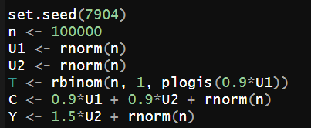
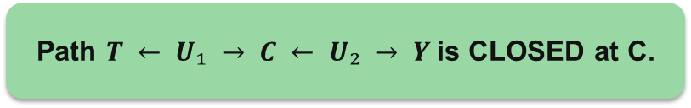
Simulation 4
U₁
U₂
C
T
Y
Path $T ← U₁ → C ← U₂ → Y$is CLOSED at C.
Adjusting for C OPENS the path.

Slide 80
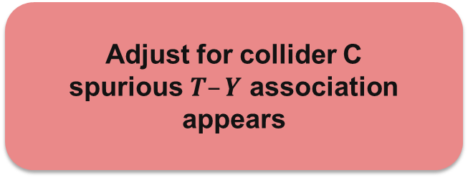
Simulation 4
set.seed(7904)
n <- 100000
U1 <- rnorm(n)
U2 <- rnorm(n)
T <- rbinom(n, 1, plogis(0.9*U1))
C <- 0.9*U1 + 0.9*U2 + rnorm(n)
Y <- 1.5*U2 + rnorm(n)
fit0 <- lm(Y ~ T)
fit1 <- lm(Y ~ T + C)
coef(fit0)["T"] : 0.01
coef(fit1)["T"] : -0.35
No adjustment
T coefficient ≈ 0
Adjust for collider C
spurious $T–Y$ association appears
Timing is not enough. We need the causal role of the variable.

Slide 81
d-Separation vs Backdoor Adjustment
d-SEPARATION
BACKDOOR ADJUSTMENT
Question:
Can we make T and Y conditionally independent?
Question:
What should we condition on to identify the total effect of T on Y?
Goal:
Block ALL paths.
Goal:
Block NONCAUSAL backdoor paths; preserve causal paths.

Slide 82
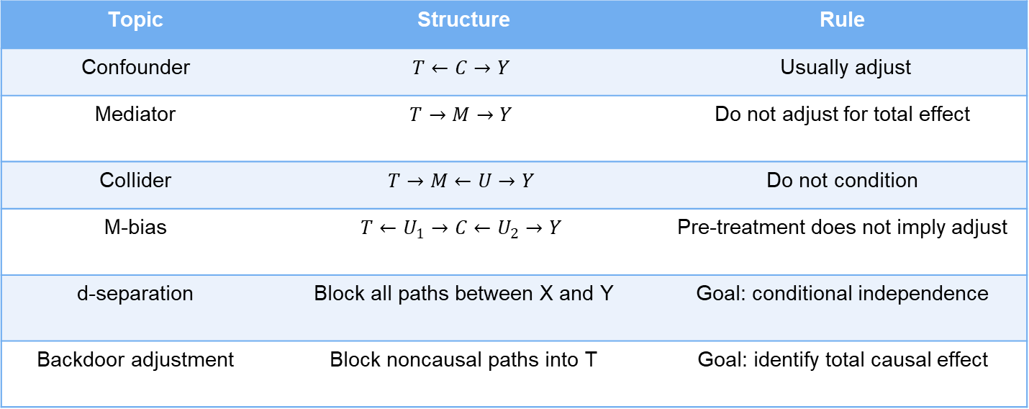
d-Separation vs Backdoor Adjustment
Topic | Structure | Rule
Confounder | $$T←C→Y$$ | Usually adjust
Mediator | $$T→M→Y$$ | Do not adjust for total effect
Collider | $$T→M←U→Y$$ | Do not condition
M-bias | $$T←U_{1}→C←U_{2}→Y$$ | Pre-treatment does not imply adjust
d-separation | Block all paths between X and Y | Goal: conditional independence
Backdoor adjustment | Block noncausal paths into T | Goal: identify total causal effect

Slide 83
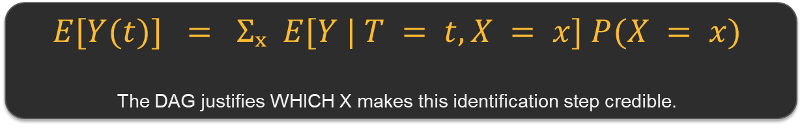
From Adjustment to Estimation
Causal
question
DAG /
assumptions
Adjustment
set X
g-formula
Estimation
→
→
→
→
We now know WHAT to adjust for. How do we use the observed data to estimate the causal effect?
$$E[Y(t)] = Σₓ E[Y | T = t, X = x] P(X = x)$$
The DAG justifies WHICH X makes this identification step credible.
Next question: Is the regression coefficient of T automatically the ATE? Only in special cases.

Slide 84
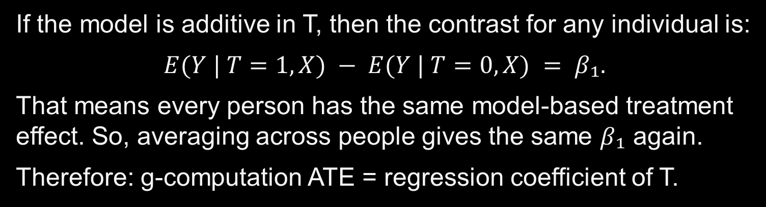

g-computation not same as regression
Simple additive model:
$E(Y | T, X) = β₀ + β₁T + β₂X$
If the model is additive in T, then the contrast for any individual is:
$$E(Y | T=1, X) − E(Y | T=0, X) = β₁.$$
That means every person has the same model-based treatment effect. So, averaging across people gives the same $β₁$ again.
Therefore: g-computation ATE = regression coefficient of T.

Slide 85
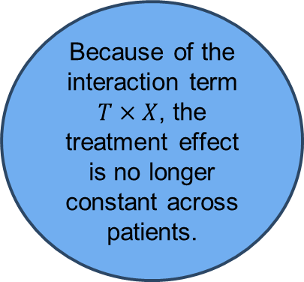
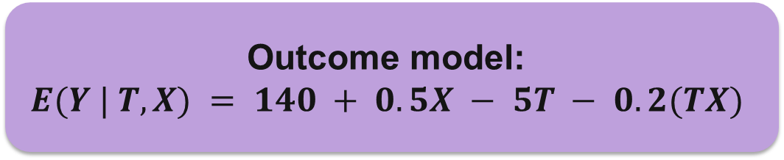
g-computation not same as regression
Clinical example
Outcome model:
$E(Y | T, X) = 140 + 0.5X − 5T − 0.2(TX)$
T = 1: antihypertensive drug; T = 0: no drug
Y = post-treatment systolic blood pressure
X = Age − 50
Suppose the effect of treatment depends on age.
Because of the interaction term $T×X$, the treatment effect is no longer constant across patients.

Slide 86
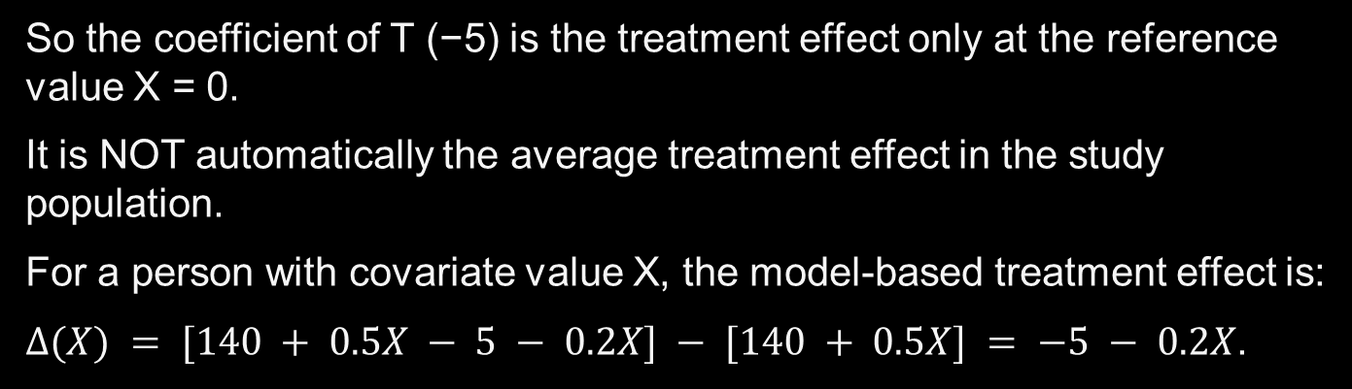
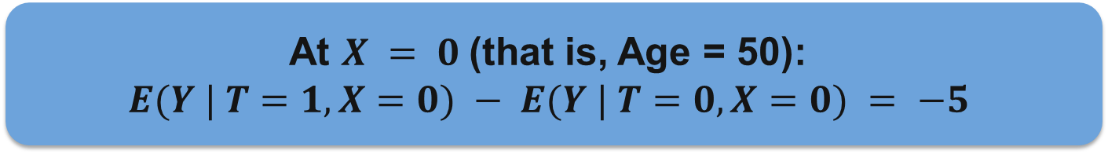
g-computation not same as regression
At $X = 0$(that is, Age = 50):
$E(Y | T=1, X=0) − E(Y | T=0, X=0) = −5$
So the coefficient of T (−5) is the treatment effect only at the reference value X = 0.
It is NOT automatically the average treatment effect in the study population.
For a person with covariate value X, the model-based treatment effect is:
$Δ(X) = [140 + 0.5X − 5 − 0.2X] − [140 + 0.5X] = −5 − 0.2X$.

Slide 87

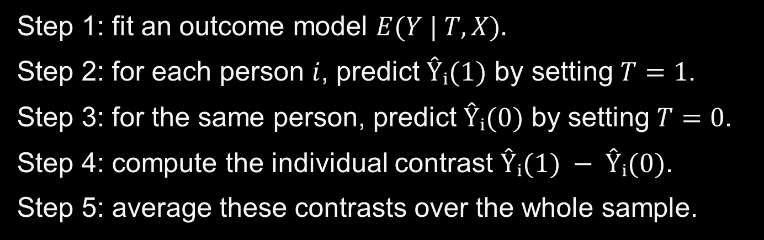
What does g-computation do?
Step 1: fit an outcome model $E(Y | T, X).$
Step 2: for each person $i$, predict $Ŷᵢ(1)$ by setting $T=1$.
Step 3: for the same person, predict $Ŷᵢ(0)$ by setting $T=0$.
Step 4: compute the individual contrast $Ŷᵢ(1) − Ŷᵢ(0)$.
Step 5: average these contrasts over the whole sample.
$$ATE_{g} = (1/n) Σ [ Ŷᵢ(1) − Ŷᵢ(0) ]$$

Slide 88
Simple Illustration I
Patient
Age
X = Age−50
Predicted effect = −5 − 0.2X
A
50
0
−5
B
60
10
−7
C
70
20
−9
g-computation average = (−5 − 7 − 9)/3 = −7

Slide 89

Simple Illustration II
Suppose the study population has mean age 65.
Then mean $X = 65 − 50 = 15$.
Average model-based treatment effect:
$ATE = E[−5 − 0.2X] = −5 − 0.2E[X] = −5 − 0.2(15) = −8$.
Regression coefficient of T = −5
g-computation ATE = −8
These differ because treatment effect varies with X.

Slide 90
g-computation vs regression
Regression coefficient of T is a conditional effect tied to the chosen parameterization.
g-computation targets a marginal causal estimand: average over the covariate distribution.
They are equal in special cases, especially a simple additive linear model with no interaction.
They generally differ with interactions, nonlinear models, logistic regression, splines, or machine learning.
Therefore: g-computation is NOT “just the T coefficient”.
regression = model
g-computation = model + counterfactual prediction + averaging

Slide 91
Short R workflow
fit <- lm(Y ~ T * X, data = dat)
dat1 <- transform(dat, T = 1)
dat0 <- transform(dat, T = 0)
y1hat <- predict(fit, newdata = dat1)
y0hat <- predict(fit, newdata = dat0)
ate_g <- mean(y1hat - y0hat)
Notice: we didn’t use coef(fit)["T"] as the ATE.
We predicted both counterfactual outcomes for everyone and then averaged.

Slide 92
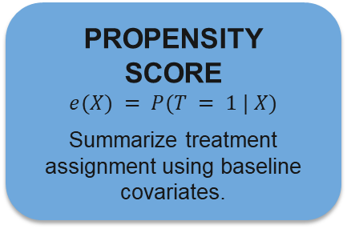
Next: Identification to Estimation
Today: Which variables should we adjust for?
Next: How do we create a fair treated-versus-untreated comparison?
PROPENSITY SCORE
$e(X) = P(T = 1 | X)$
Summarize treatment assignment using baseline covariates.
MATCHING & WEIGHTING
Build a comparison population in which treated and untreated groups are more comparable.
DIAGNOSTICS
Overlap, positivity, covariate balance, and what to do when comparable patients do not exist.
Preview question: Can an observational study be reweighted to mimic some features of randomization?

